Slide 1
Restoration and development of Arm's Java-based LEGv8 ISA simulator
Graduating student - Simone Deiana
Supervisor - Alberto Carini
Department of Engineering and Architecture
Trieste, 30 August 2024

Slide 2
INTRODUCTION
Restoration and development of
Arm's Java-based LEGv8 ISA simulator​

Slide 3
INTRODUCTION
Restoration and development of
Arm's Java-based LEGv8 ISA simulator​

Slide 4
INTRODUCTION
Restoration and development of
Arm's Java-based LEGv8 ISA simulator​

Slide 5
WHAT IS LEGv8?
Restoration and development of
Arm's Java-based LEGv8 ISA simulator​

Slide 6



WHAT IS LEGv8?
AN ISA FOR LEARNING COMPUTER ARCHITECTURES
David A. Patterson
Peg Skorpinski, CC BY-SA 3.0 <https://creativecommons.org/licenses/by-sa/3.0>, via Wikimedia Commons
John L. Hennessy
Eric Chan, CC BY 2.0 <https://creativecommons.org/licenses/by/2.0>, via Wikimedia Commons
From Computer Organization and Design ARM Edition: The Hardware Software Interface - Patterson, D.A. and Hennessy, J.L.

Slide 7
WHAT IS LEGv8?
THE DESIGN PHILOSOPHY
As simple as it can be...
… but with a modern design
Heavily inspired by ARMv8, almost a "subset"

Slide 8
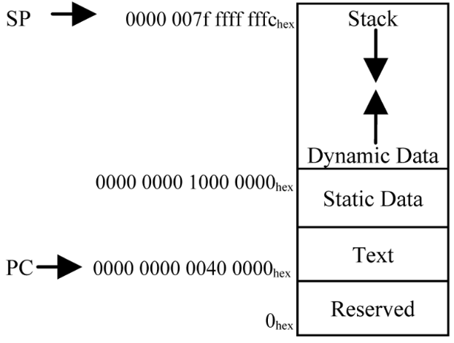
WHAT IS LEGv8?
THE MEMORY
64-bit addresses
Harvard model

Slide 9
WHAT IS LEGv8?
THE REGISTERS
32 64-bit "X" integer registers
32 64-bit "D" floating-point registers
32 32-bit "S" floating-point "registers"

Slide 10
WHAT IS LEGv8?
THE INSTRUCTIONS
64-bit integer and IEEE-754 floating-point arithmetic
Designed and optimized for pipelined execution

Slide 11
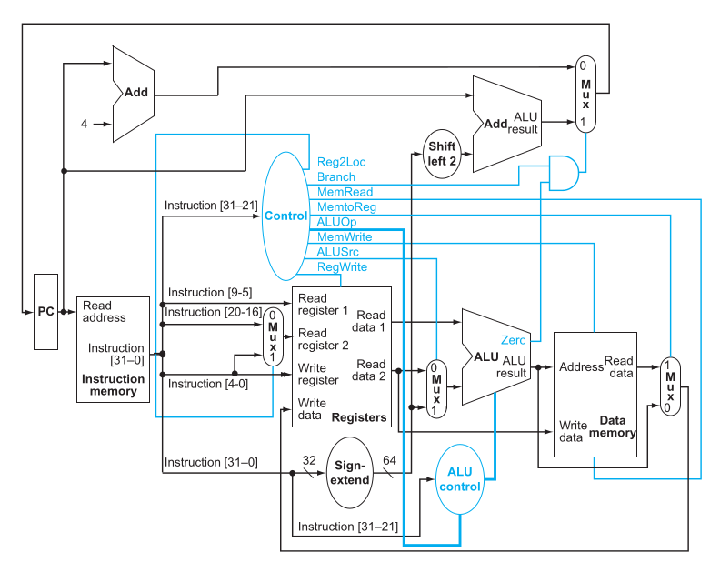
WHAT IS LEGv8?
THE DATAPATH
From Computer Organization and Design ARM Edition: The Hardware Software Interface - Patterson, D.A. and Hennessy, J.L.

Slide 12
WHAT IS LEGv8?
THE DATAPAH
INSTRUCTION MEMORY
From Computer Organization and Design ARM Edition: The Hardware Software Interface - Patterson, D.A. and Hennessy, J.L.

Slide 13
WHAT IS LEGv8?
THE DATAPATH
REGISTERS AND CONTROL UNIT
From Computer Organization and Design ARM Edition: The Hardware Software Interface - Patterson, D.A. and Hennessy, J.L.

Slide 14
WHAT IS LEGv8?
THE DATAPATH
ALU
From Computer Organization and Design ARM Edition: The Hardware Software Interface - Patterson, D.A. and Hennessy, J.L.

Slide 15
WHAT IS LEGv8?
THE DATAPATH
DATA MEMORY
From Computer Organization and Design ARM Edition: The Hardware Software Interface - Patterson, D.A. and Hennessy, J.L.

Slide 16
WHAT IS LEGv8?
THE STAGES
FETCH
From Computer Organization and Design ARM Edition: The Hardware Software Interface - Patterson, D.A. and Hennessy, J.L.

Slide 17
WHAT IS LEGv8?
THE STAGES
DECODE
From Computer Organization and Design ARM Edition: The Hardware Software Interface - Patterson, D.A. and Hennessy, J.L.

Slide 18
WHAT IS LEGv8?
THE STAGES
EXECUTE
From Computer Organization and Design ARM Edition: The Hardware Software Interface - Patterson, D.A. and Hennessy, J.L.

Slide 19
WHAT IS LEGv8?
THE STAGES
MEMORY ACCESS
From Computer Organization and Design ARM Edition: The Hardware Software Interface - Patterson, D.A. and Hennessy, J.L.

Slide 20
WHAT IS LEGv8?
THE STAGES
WRITE BACK
From Computer Organization and Design ARM Edition: The Hardware Software Interface - Patterson, D.A. and Hennessy, J.L.

Slide 21
WHAT SIMULATOR, AND WHY?
Restoration and development of
Arm's Java-based LEGv8 ISA simulator

Slide 22

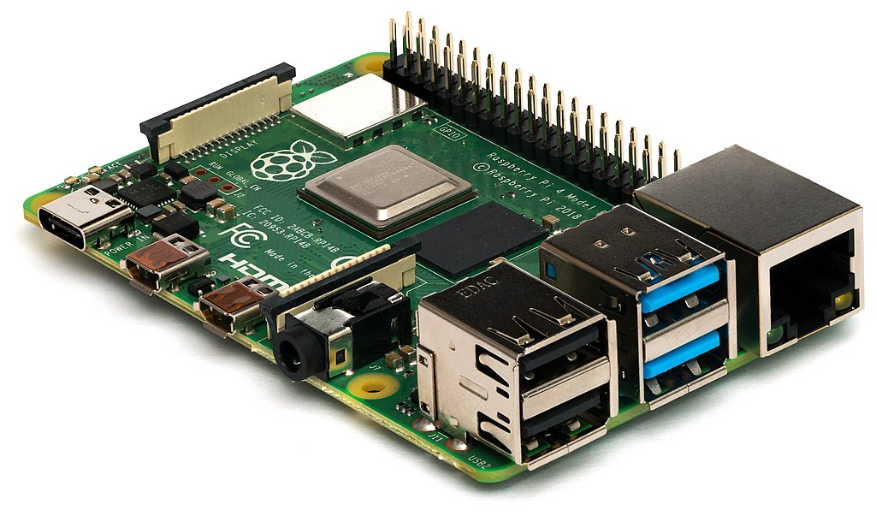
WHAT SIMULATOR, AND WHY?
NO HARDWARE FOR LEGv8 => NEED A SIMULATOR
Michael H. („Laserlicht“) / Wikimedia Commons

Slide 23
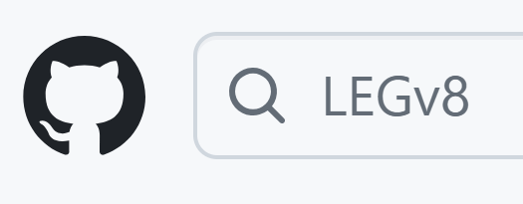
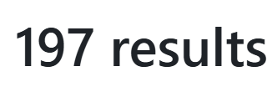
WHAT SIMULATOR, AND WHY?
BUT WHICH ONE?

Slide 24
WHAT SIMULATOR, AND WHY?
THE PROBLEM:
NO SOFTWARE CAN YET SIMULATE THE ENTIRE LEGv8 ISA!

Slide 25
WHAT SIMULATOR, AND WHY?
THE SOLUTION:
Write one from scratch
OR (BETTER)​
Improve one that already exists

Slide 26
WHAT SIMULATOR, AND WHY?
ARM HAS OFFICIALLY MADE A LEGv8 SIMULATOR
GOOD!
IT'S INCOMPLETE AND BROKEN
BAD!

Slide 27
WHAT SIMULATOR, AND WHY?
WHAT STANDS OUT:
Written in Java (high level, extensible)
Distributed as a web application
Nice, functional UI
Closely follows the textbook

Slide 28
FIXING AND RESTORING THE SIMULATOR
STRUCTURE OF THE SIMULATOR
EXECUTION MODE
CODE PARSER/LEXER
INSTRUCTION
CPU
MEMORY

Slide 29
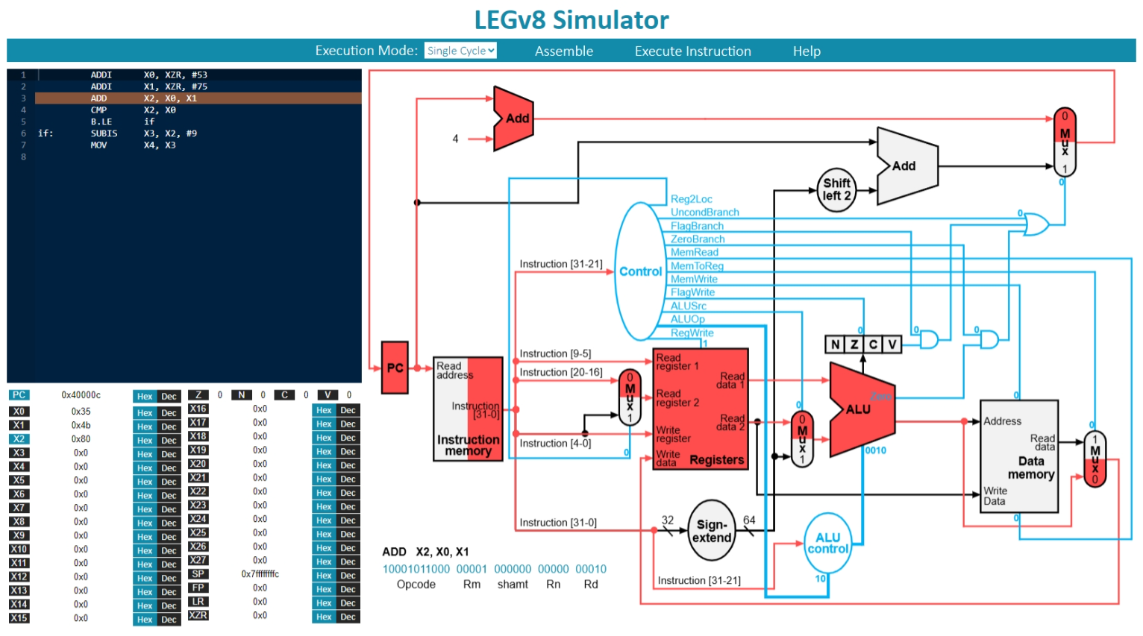
WHAT SIMULATOR, AND WHY?

Slide 30
FIXING AND RESTORING
THE SIMULATOR
Restoration and development of
Arm's Java-based LEGv8 ISA simulator​

Slide 31
FIXING AND RESTORING THE SIMULATOR
COMPARISONS DON'T WORK!
No "if-else" conditionals
No "switch-case" conditionals
No "while" loops
No "for" loops

Slide 32
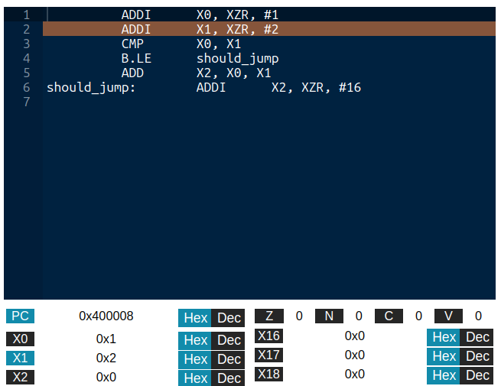
FIXING AND RESTORING THE SIMULATOR
THE COMPARISON BUG
X0 = 1, X1 = 2

Slide 33
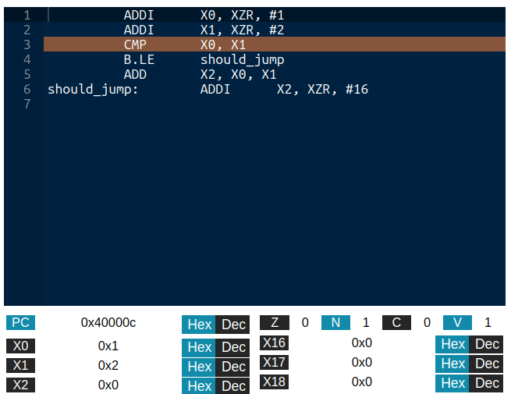
FIXING AND RESTORING THE SIMULATOR
THE COMPARISON BUG
COMPARE X0 WITH X1

Slide 34
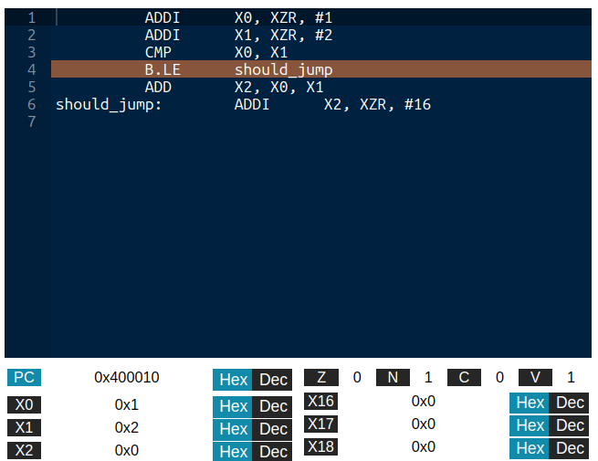
FIXING AND RESTORING THE SIMULATOR
THE COMPARISON BUG
1 <= 2 ?
OF COURSE, LET'S JUMP!

Slide 35
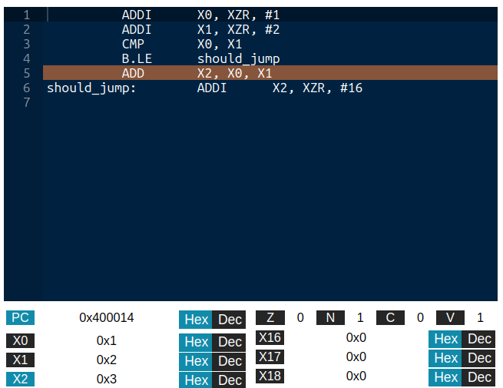
FIXING AND RESTORING THE SIMULATOR
THE COMPARISON BUG
...OR NOT

Slide 36
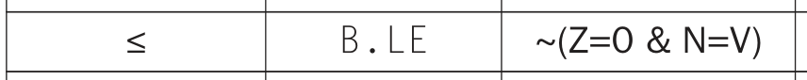
FIXING AND RESTORING THE SIMULATOR
THE FLAGS ARE SET WRONG!
HOW THEY SHOULD BE
HOW THEY ARE
¬(Z=0 ∧ N=V) = ¬(TRUE ∧ TRUE) = FALSE

Slide 37
FIXING AND RESTORING THE SIMULATOR
BRANCH AND LINKS DON'T WORK!
void subroutine(arg1, ...)
float function(arg1, ...)
CAN'T REUSE CODE

Slide 38
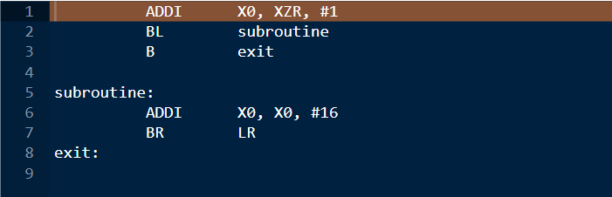
FIXING AND RESTORING THE SIMULATOR
THE BRANCH AND LINK BUG
PROGRAM COUNTER: 0x0
RETURN ADDRESS: 0x0

Slide 39
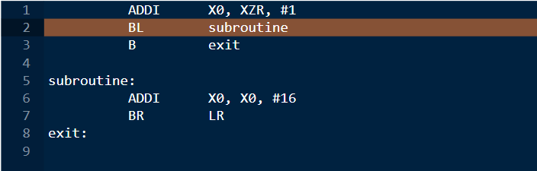
FIXING AND RESTORING THE SIMULATOR
THE BRANCH AND LINK BUG
PROGRAM COUNTER: 0x4
RETURN ADDRESS: 0x0

Slide 40
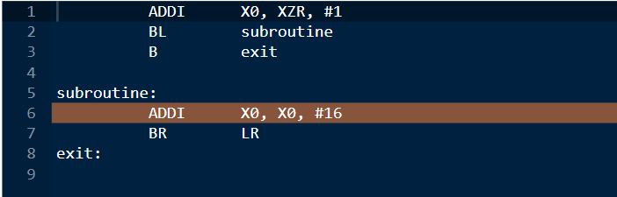
FIXING AND RESTORING THE SIMULATOR
THE BRANCH AND LINK BUG
PROGRAM COUNTER: 0xC
RETURN ADDRESS: 0xC

Slide 41
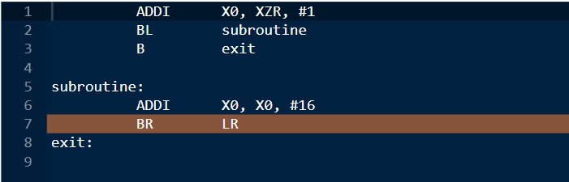
FIXING AND RESTORING THE SIMULATOR
THE BRANCH AND LINK BUG
PROGRAM COUNTER: 0x10
RETURN ADDRESS: 0xC

Slide 42
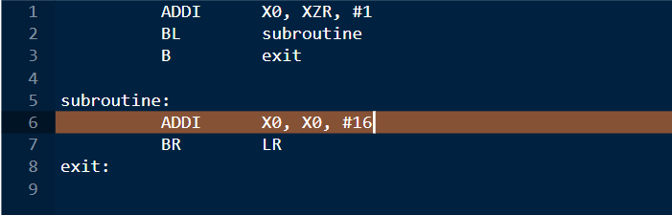
FIXING AND RESTORING THE SIMULATOR
THE BRANCH AND LINK BUG
IT DOESN'T GO BACK!

Slide 43
FIXING AND RESTORING THE SIMULATOR
IT SHOULD GO HERE!
ADDRESS: 0x8
PROGRAM COUNTER: 0xC
RETURN ADDRESS: 0xC

Slide 44
FIXING AND RESTORING THE SIMULATOR
ALL FIXED, BUT...
NOBODY KNOWS HOW IT WORKS!

Slide 45
FIXING AND RESTORING THE SIMULATOR
THE PROJECT'S DEPENDENCIES
GWT
AceGWT
THE SIMULATOR

Slide 46
FIXING AND RESTORING THE SIMULATOR
GWT
Framework (formerly) from Google
Generates web applications (client-server, client only) from Java
Emulates Java's JVM with JavaScript

Slide 47
FIXING AND RESTORING THE SIMULATOR
GWT
Old, outdated, barely supported
Convoluted custom build tools
Limited emulation of JVM
Basically needs Eclipse plug-in for real development

Slide 48
FIXING AND RESTORING THE SIMULATOR
AceGWT
Provides GWT bindings for the Ace editor
Can be used like normal GWT component
Also old, outdated, and unsupported

Slide 49
FIXING AND RESTORING THE SIMULATOR
WORKING IT OUT:
Need old version of Eclipse, and Eclipse GWT plug-in
Reverse engineer the dependencies and where they are needed
Configure the project to stop failing

Slide 50
FILLING THE GAPS
Restoration and development of
Arm's Java-based LEGv8 ISA simulator​

Slide 51
FILLING THE GAPS
WHAT IS THE SIMULATOR MISSING?
Incomplete integer arithmetic
No IEEE-754 arithmetic and data instructions
No visualization for the stack memory

Slide 52
FILLING THE GAPS
THE MISSING INTEGER-BASED INSTRUCTIONS
MUL – LOWER 64 BITS OF THE MULTIPLICATION
SMULH – HIGHER 64 BITS OF THE SIGNED MULTIPLICATION
UMULH – HIGHER 64 BITS OF THE UNSIGNED MULTIPLICATION
SDIV – SIGNED DIVISION
UDIV – UNSIGNED DIVISION
LDA – LOAD ADDRESS OF A LABEL IN A REGISTER

Slide 53
FILLING THE GAPS
UMULH: A CASE STUDY
Takes two 64-bit unsigned integer values
Extends them to 128 bits unsigned
Performs 128-bit product
Saves higher 64 bits to destination

Slide 54
FILLING THE GAPS
PROBLEM 1
Java does not have primitive 128-bit integer types
Product of 64-bit integers truncated
The BigInteger library exists
GWT 2.7 doesn't emulate it (2.8 does)

Slide 55
FILLING THE GAPS
PROBLEM 2
Primitive integers are signed
BigInteger also signed
Bitmask converts 64-bit unsigned integers to 65-bit signed, perform signed multiplication, take the higher bits

Slide 56
FILLING THE GAPS
CAN'T SEE THE STACK
Fundamental for testing and debugging complex programs (now we can write them)
Useful to understanding LEGv8 and stack management
Visible in most simulators

Slide 57
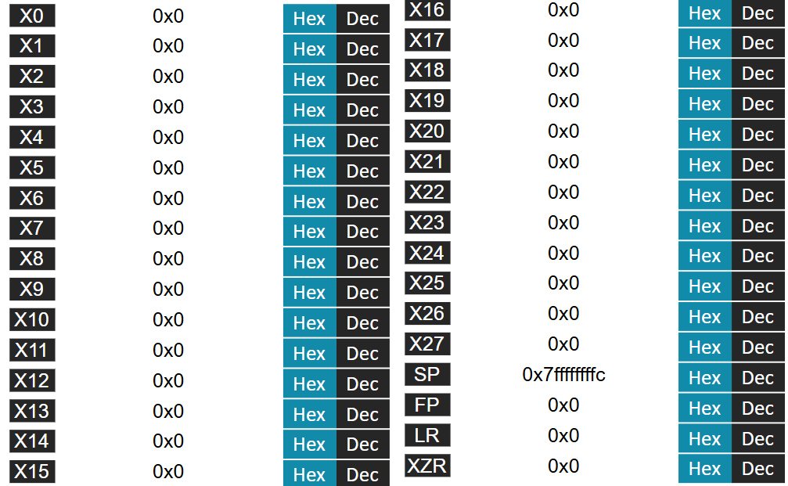
FILLING THE GAPS
THE INTEGER REGISTERS VIEW

Slide 58
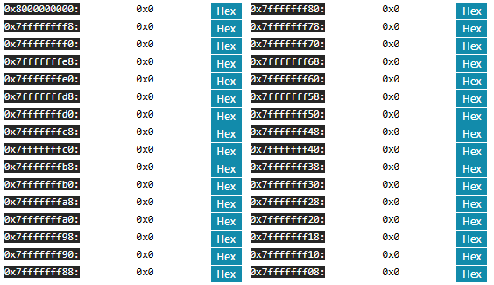
FILLING THE GAPS
THE NEW STACK VIEW

Slide 59
FILLING THE GAPS
ADDING FLOATING-POINT SUPPORT
FADDS, FADDD – ADD TWO IEEE-754 VALUES
FSUBS, FSUBD - SUBTRACT TWO IEEE-754 VALUES
FMULS, FMULD - MULTPLY TWO IEEE-754 VALUES
FDIVS, FDIVD – DIVIDE TWO IEEE-754 VALUES
LDURS, LDURD – LOAD IEEE-754 VALUE FROM MEMORY
STURS, STURD - STORE IEEE-754 VALUE TO MEMORY
FCMPS, FCMPD – COMPARE TWO IEEE-754 VALUES

Slide 60
FILLING THE GAPS
ARITHMETICAL INSTRUCTIONS
(FADDD, FDIVS, …)
Native Java support for IEEE-754 with float and double types
Native Java support for IEEE-754 arithmetical operations
Straight forward implementation

Slide 61
FILLING THE GAPS
MEMORY ACCESS INSTRUCTIONS
(LDURS, STURD, …)
Simulator uses long values to store bits in memory
Use exising longs and ints as raw bits
Use Java Double.longBitsToDouble and Double.doubleToLongBits to convert before memory

Slide 62
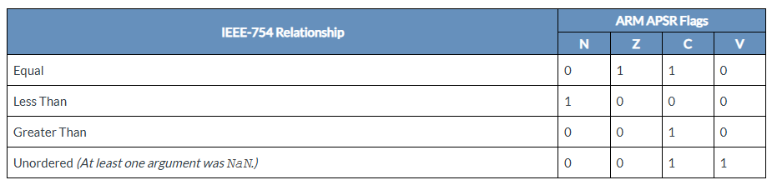
FILLING THE GAPS
COMPARISON INSTRUCTIONS
(FCMPS, FCMPD)
LEGv8 does not specify flag-setting conditions for IEEE-754 comparisons
Use ARMv8's ones

Slide 63
FILLING THE GAPS
SHOWING THE REGISTERS

Slide 64
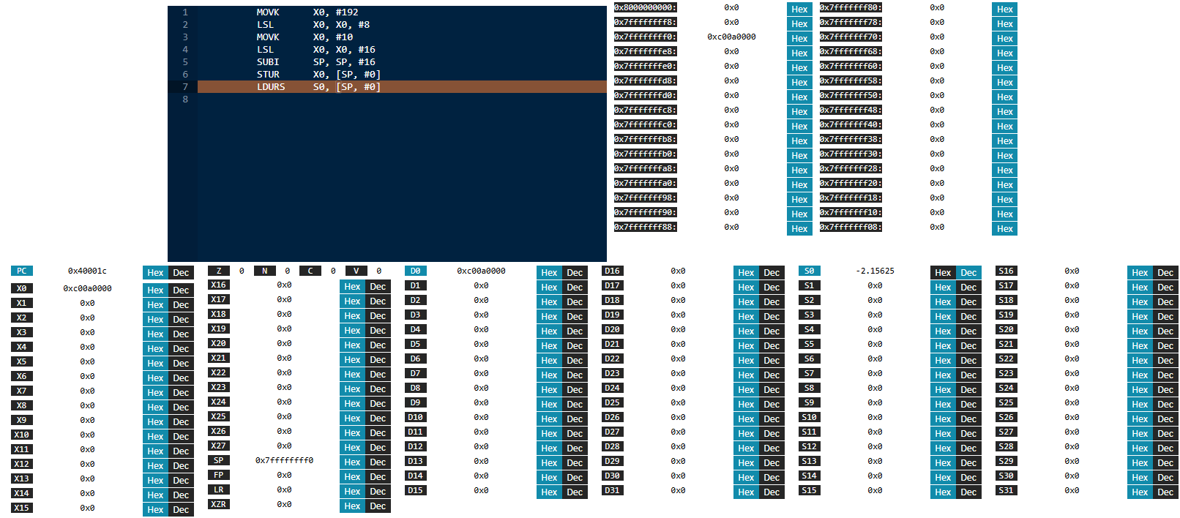
FILLING THE GAPS
THE FINAL VIEW

Slide 65
FILLING THE GAPS
THE CHERRY ON TOP: MODERNIZING THE BUILD SYSTEM

Slide 66
FILLING THE GAPS
INTEGRATING MAVEN
Latest GWT and AceGWT support Maven
Integrated Maven into the simulator
Can now use other IDEs, Java 21, GWT 2.11
To develop, download the code and run mvn package. That's it.

Slide 67
CONCLUSIONS
Arm's LEGv8 simulator finally working
Only one to implement every LEGv8 instruction
Can now be developed with modern tools, set-up and build in seconds

Slide 68
THANK YOU FOR
YOUR ATTENTION
THESIS AVAILABLE HERE
SIMULATOR AVAILABLE HERE

